Slide 1
Project 2: Semantic Data Generation
Liam N., Varun L., Loc H., Suchitra C., Phuc D.
Link to Github: https://github.com/liam-nguyen/CECS-571/tree/master/project_2/project2_maven

Slide 2
Criteria for choosing our datasets
Available
Public knowledge domain (Data.gov)
Relationship between datasets
Format: CSV, JSON
Answer the question

Slide 3
Our Question
Question: Given a hospital name, what is the relationship between its Medicare reimbursement and its overall quality of treatment?
Medicare Spending: Medicare reimbursements of all departments of a hospital in a given year
Quality: the score a hospital received in a given year

Slide 4
How to answer?
3 datasets:
Hospital General Information
Hospital Medicare Spending Claim (2018)
Hospital Timely and Effective Care (2018)
Hospital Medicare Spending Claim
Hospital Average Medicare Spending
State Average Medicare Spending
National Average Medicare Spending
Hospital Timely and Effective Care
Hospital Score

Slide 5
Technical - Datasets
We just want an overall statistics
ID is the same across datasets
Group data by ID
Remove columns
Incomplete information
Irrelevant information

Slide 6
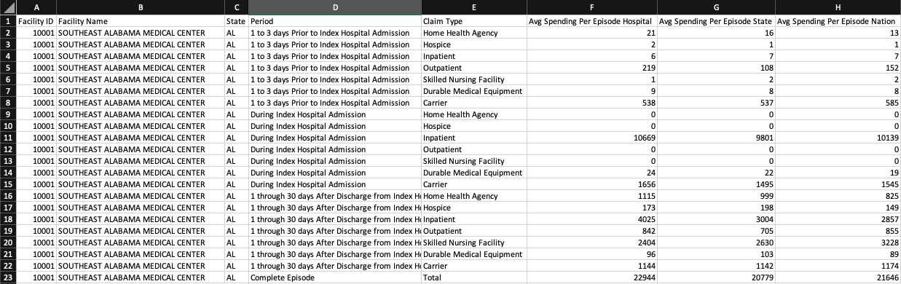
Aggregate Data by ID
Before
After

Slide 7
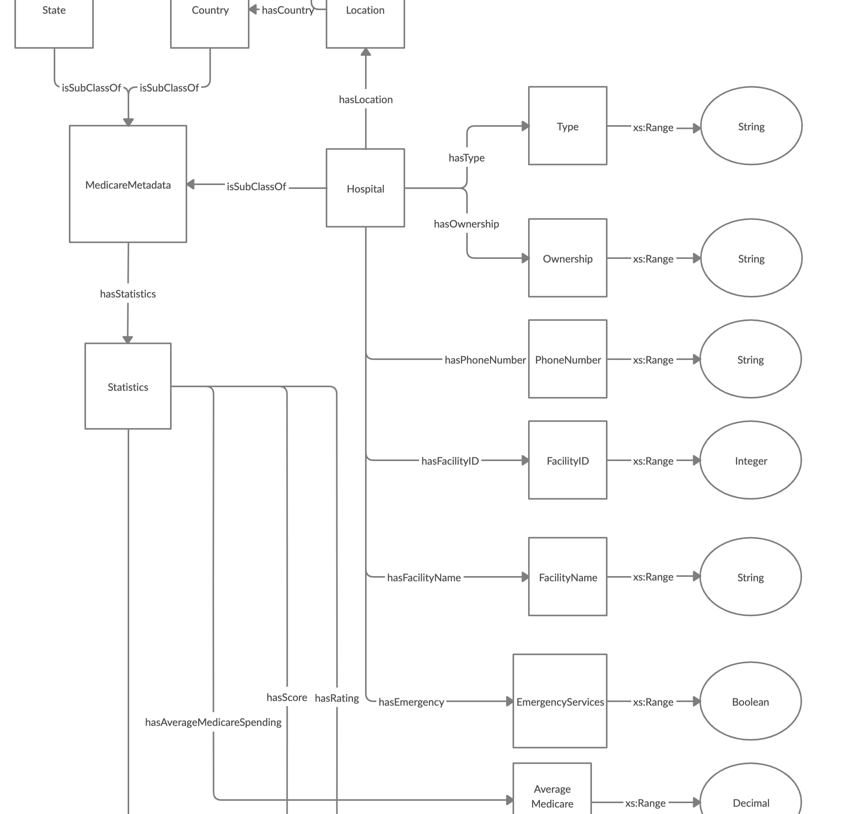
Technical - Ontology
Design: 3 ontologies, one for each dataset or 1 ontology for all dataset?
All datasets contain similar information about hospital, 1 ontology model is our choice
Team collaboration:
https://creately.com/
Iterative design

Slide 8
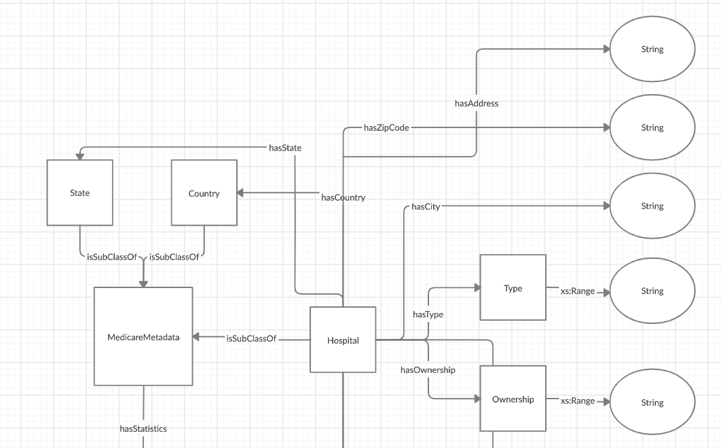
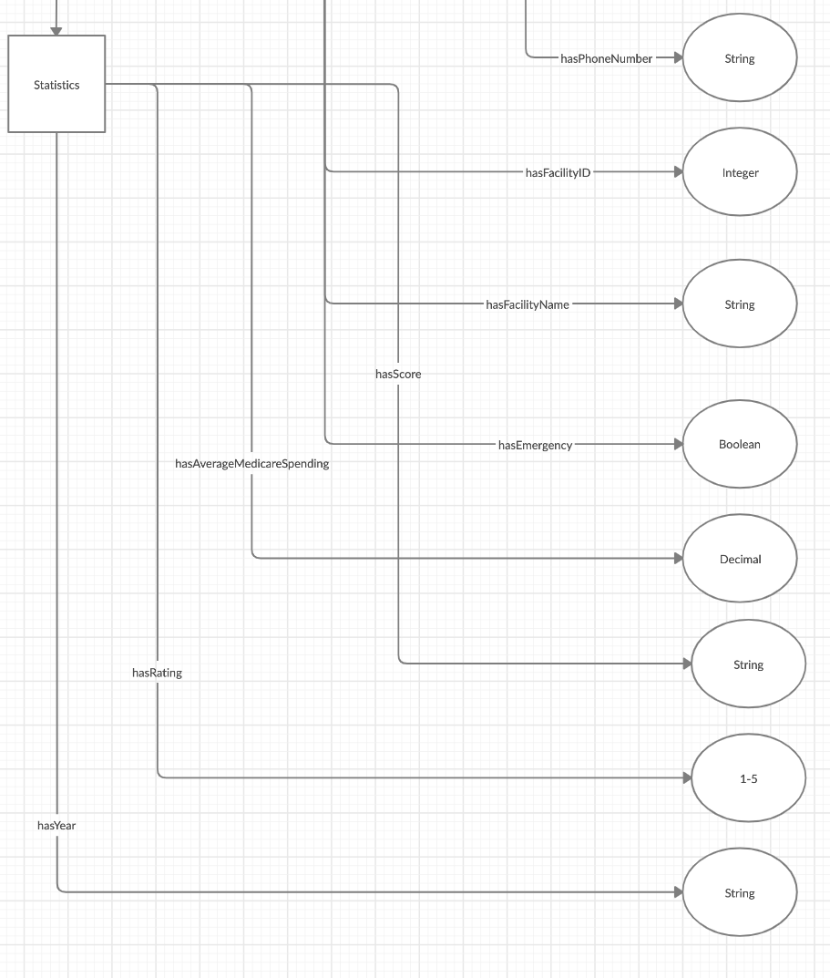
Ontology Design
Top
Bottom

Slide 9
Technical - Apache Jena (Java)
Apache Jena
A free and open source Java framework for building Semantic Web and Linked Data applications.
Support RDF, RDFS, OWL
Apache Maven
is a software project management and comprehension tool
XML
Package into JAR

Slide 10
Technical - Steps from CSV to OWL
Build
Classes
Properties
Relationships
Triplet
Gather
Parse CSVs
Create instances for each classes
Create triplet with data
Create
Create instances for each hospital, state and country

Slide 11
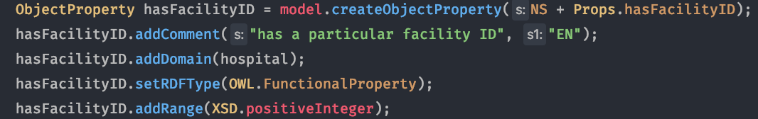
Step 1 - Class and Property (Apache Jena)
Class
Class relationship
Property

Slide 12

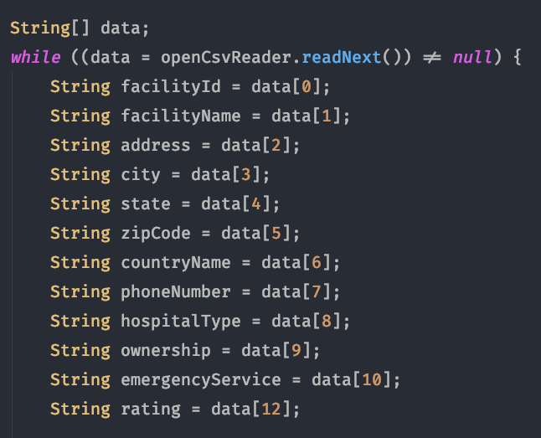
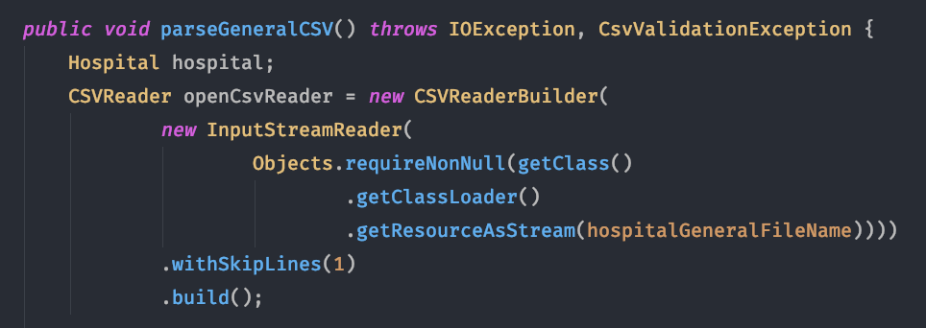
Step 2 - Parse CSV
1) HashMap to store instances
3) Read each column
2) Read CSV

Slide 13
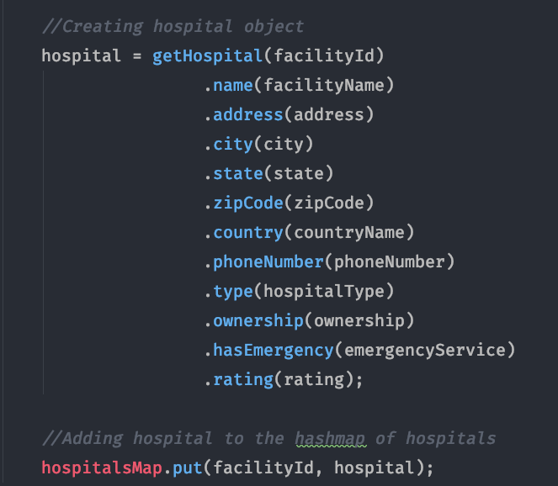
Step 2 - Parse CSV (continued)
4) Save information into hospital instance

Slide 14
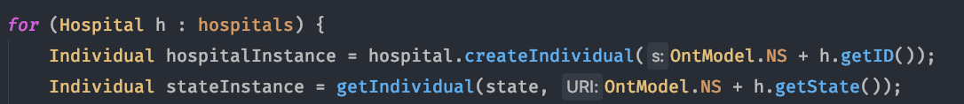
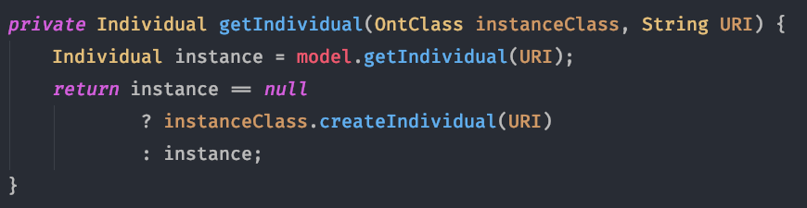
Step 3 - Create OWL Instances
1) Method Signature
2) Get OWL Class from the model
3) Create class instance
4) Get OWL Property from the model
5) Add triplet to the model
getIndividual() implementation:
Use Jena's built in function
Get slower as number of instances grow in the model

Slide 15
Obstacles
Hospital with incomplete information:
Name, Spending, Rating, Score
Exclude from ontology
Searching for an Individual instance in OWL is expensive.
It gets worse when model grows.

Slide 16
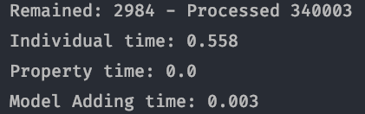
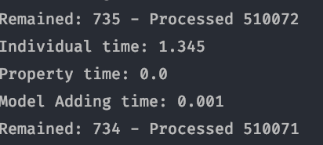
Step 3 - Create OWL Instances (Continue)
Total time to search individual instances
Total time to add all triplets
# remained hospitals
Total time to add all triplets
Hospital ID
For each hospital:
Look up 9 individual instances
Get 10 classes
Get 16 properties
On Start
After a while...
Only get worse as the model grows

Slide 17

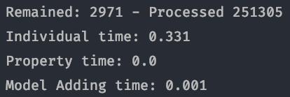
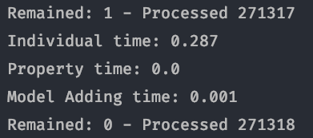
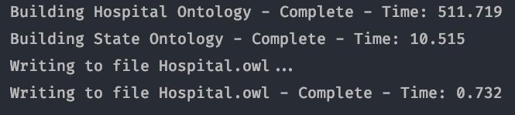
Step 3 - Create OWL Instances (Continue)
Solution:
Use a map to store (URI, Individual)
Trade memory for constant look-up time
On Start
Last item
Total time for each tasks

Slide 18
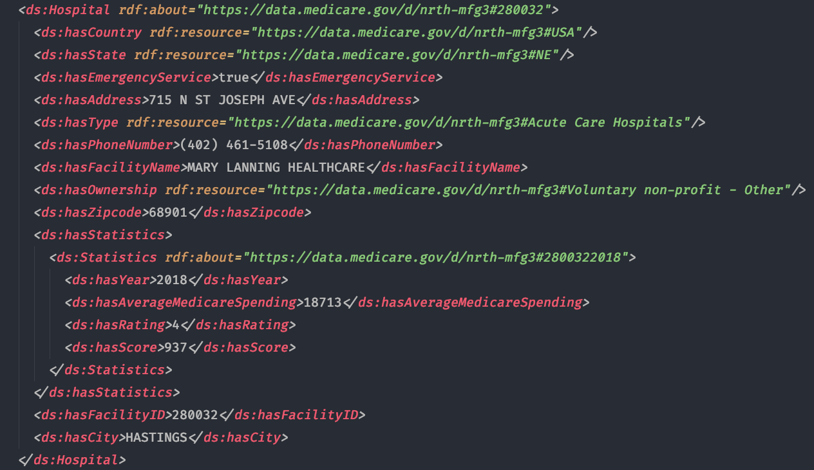
Final Output - Hospital.owl

Slide 19
Thank you

